Slide 1
Call For Proposals UGA22003-10004 Supporting vulnerable youth to develop sustainable micro- and small businesses for enhanced resilience and economic integration in West Nile region
Information sessions – proposal stage

Slide 2
Presentation outline
Introduction & objectives - RECAP of the CfPs (slides 3-6 - Charles)
Concept Note selection process summary (slides 7-8 - Jude)
Proposal template
Annex A; part B, proposal (slides 9-18 - Jan)
M&E logical framework, Indicators (slides 19-27 - Adam)
Discussion on budgeting (Budget template) (slides 28-36 - Hassan)
Application procedure/next steps (slides 37-44 - Paska)

Slide 3
Call Objectives
1. Introduction & objectives - RECAP of the CfPs
General objective
The livelihoods of vulnerable youth, including young women, and refugees in West Nile and Kiryandongo, are improved and sustained through access to self-employment opportunities
Specific objective
Vulnerable youth, including young women, start and grow sustainable micro- or small businesses, through enhanced access to quality business development support

Slide 4
Call objectives (overall)
1. Introduction & objectives - RECAP of the CfPs
1000 vulnerable youth, including young women (ie. Skilled, unemployed youth as well as youth business-owners), are supported to start or grow sustainable micro- and small businesses through quality business development support;
1000 vulnerable youth (the same target group as under expected result 1), are supported to access affordable finance and capital to start or grow their micro- or small businesses;
Good practices in (green/climate-smart) business development services for the economic integration of vulnerable youth are scaled-up.

Slide 5
Result 4 - Entrepreneurship promotion
1. Introduction & objectives - RECAP of the CfPs
Target groups
Un(der)employed, skilled youth
→ start a sustainable business
2) Youth/youth group business owners
→ Operate a sustainable business
Vulnerable youth
BUT w/min required skills & capacity
NOT non-skilled youth in need of initial TVET

Slide 6
CN (stage 1) selection process
2. Concept note selection process summary
65 concepts were received
21 applications failed at admissibility, while 44 proceeded to technical evaluation.
7 shortlisted concept notes invited for 2nd stage (absorbing 300% of total call volume; 4 for lot 1, 3 for lot 2)
Deadline submission proposals = 9/12 at 5PM

Slide 7
Evaluation - Concept note vs Proposals
2. Concept note selection process summary
Focus CN → RELEVANCE of proposed action
Focus Proposals
RELEVANCE of proposed methodology/strategic approaches
EFFECTIVENESS & FEASIBILITY
CAPACITY/EXPERIENCE

Slide 8
Content - Concept note vs Proposals
2. Concept note selection process summary
No substantial changes to the initial CN (e.g. changes to lot, districts, co-applicant)
Requested contribution cannot vary more than 20% from initial estimate + must remain between the min and max that can be requested (150,000 – 500,000 EUR for lot 1 and 150,000 – 350,000 EUR for lot 2)

Slide 9
a) Annex A; part B proposal
3. Proposal template
a) Annex A; part B proposal
Detailed description of the action & methodology
6 sections (description, strategic approach, methodology (who/what/when/how), action plan, risks & assumption, sustainability)
log frame
budget
Administrative data and information for lead and co-applicant(s)
The lead applicant’s experience for similar and other actions
Capacity to manage and perform actions (experience in the sectors)
Resources (financial data, source of financing, number of people employed)
The co-applicant(s)’ experience for similar and other actions
History of cooperation with lead applicant
Capacity to manage and implement actions (experience in the sectors)
The associates (if any) - participate actively in the action, but are not eligible for grants and only qualify to receive daily allowances and travelling expenses)
Mandate for each co-applicant and associates signed
Declaration for lead applicant signed
*any sub-grants must be indicated under methodology

Slide 10
Strategies promoted RECAP
RECAP of the CfPs
Sustainable micro- and small business development initiatives, integrating:
Business development support (training, technical assistance, coaching)
Innovative approaches, (best-available) technologies and good practices (ie. green agriculture, agro-ecological principles, digital solutions/tools, …)
Engagement of other private sector actors to mobilize sector-specific expertise and/or to support development of business relationships (B2B, sales or input agreements);
Strategies to enhance beneficiaries’ access to affordable finance and capital;
Where relevant, strategies towards enhanced access to assets, including land & inputs (without distorting the local ecosystem and market);
Strategies to support adherence to quality standards of products and services;
Support to formalization and/or occupational licensing where relevant (ie. When strongly linked to market access);
Support to product diversification through value addition;
Outreach and awareness activities;
Other social inclusion strategies that help remove gender and other vulnerability-related barriers

Slide 11
! Attention points !
Detail/elaborate approaches/methodology of different elements of the action (e.g. access to finance strategies, business development support scheme, engagement of the private sector, social inclusion strategies, value chain coordination etc. - No skilling program!)
Clarify clearly strategies to promote income diversification/resilience (esp for lot 1) and food security - of different value chains; are they integrated in mixed income activities - HOW? (generally missing in many CNs!)
Highlight linkages between the selected value chains (why did you chose these specific VCs; how the action intends to complement business aspects to ensure continuous income generation-seasonality?) and at the different nodes of the value chain
Clarify clearly (other) strategies related to market access/value chain coordination/linkages between segments
Besides innovations, highlight and elaborate elements of added value (eg. Business models that address value chain constraints or missing services in a value chain)

Slide 12
! Attention points !
Lot 1: clarify clearly how agricultural and agro-ecological approaches are promoted/integrated
Incorporate technical aspects demonstrating the potential to contribute to sustainable adoption of good practices and contribute to environmental conservation
Clarify clearly the role of (and/or engagement with) each stakeholder in implementation:
applicant, any co-applicant(s), any sub-grantee, any associate
External stakeholders: community, local govt, private sector
Ensure logical flow between activities & structuring between different phases (eg. inception, baseline, implementation, end-line)
Ensure 100% alignment of structure between narrative, activity plan, budget & logframe

Slide 13
! Attention points !
Provision of start-up kits or inputs, tailored to specific business needs or business plans developed by targeted youth (if applicable)
maximum 15% of the budget
to provide a strategy on how the kits will effectively promote sustainable business development and not distort the local ecosystem and market

Slide 14
Sub-grants RECAP (if applicable)
RECAP of the CfPs
Sub-granting to sub-recipients of sub-grants is allowed for 2 categories;
Micro-business sub-grants to youth-business owners for investment/capital
Sub-grants to processors/off-takers for value chain integration of smallholder suppliers
Sub- granting is optional not mandatory
In application form, the following details should be clearly provided:
The description of the objectives and results to be achieved with these sub- grants, the fundamental principles, the key concepts, the mechanisms, the actors and their role in the management process;
The criteria and modalities for the allocation of grants, accessibility conditions sub-beneficiaries, conditions for the admissibility of sub-projects, eligibility conditions for activities, costs and expenses;
The procedures for examining and awarding applications;
The maximum amount that can be allocated by sub-beneficiary;
The terms of contractualization with the sub-beneficiary;
The procedures and modalities for disbursing resources;
The procedures and modalities for technical and financial monitoring;
The procedures and modalities of control.

Slide 15
Sub-grants RECAP (if applicable)
RECAP of the CfPs
I. Micro-business sub-grants – conditions:
The maximum amount for the sub-grants under this category is EUR 250 per supported youth/youth owned business;
To be eligible for a micro business grant, supported youth must have successfully completed the business support scheme organized under the action and present a sound and viable business plan/model;
Approval of micro business grants for supported youth/youth-owned businesses will be done by a selection committee which is to include representatives of Enabel, and by applying different evaluation criteria including (but not limited to) the viability of the business plan/model, vision/sound projections, financial need and relevance, technical and economic feasibility, experience and motivation of the applicant, etc.
Types of activities eligible for micro business grants include purchase of equipment, raw materials and inventory, marketing and advertising activities, or start-up related costs for newly developed businesses;
The following costs are ineligible for sub-granting: non-business-related costs (e.g. personal expenses or assets) and repayment of existing debts or loans.
Payment modalities cannot include any payment in cash.

Slide 16
Sub-grants RECAP (if applicable)
RECAP of the CfPs
II. Sub-grants to processors/off-takers - conditions (1/2):
The maximum amount for the sub-grants under this category is EUR 40,000 per processor/off-taker;
Maximum 15% of the total budget can be allocated for sub-grants under this category;
Activities for sub-grants under this category must include training/extension services to the targeted youth for enhanced productivity and quality management. Other eligible types of activities for sub-granting include provision of quality inputs, logistical support or set-up of collection points or services;

Slide 17
Sub-grants RECAP (if applicable)
RECAP of the CfPs
II. Sub-grants to processors/off-takers - conditions (2/2):
To be eligible to apply sub-grants under this category, applicants must:
Have demonstrated experience in this type of partnerships in the target region with processors/off-takers;
Already identify and motivate the selection of the processor/off-taker(s) they would engage in the implementation of the action through sub-grants in their application and annex a signed Memorandum of Understanding with the identified entity(ies), demonstrating the commitment of both parties to the proposed partnership(s);
To be eligible for sub-grants, processors/off-takers must:
Establish decent and sustainable sales agreements with the youth producers/suppliers they are to support (i.e. long-term contracts with decent market prices) to ensure stable and inclusive market access/supply chain integration;
Have existing training/extension services to producers/suppliers promoting their inclusive integration into the entity's supply chain;
Source raw materials locally
Commitment to co-finance the actions financially or through in-kind support.
Payment modalities should include disbursements in instalments via bank transfer.

Slide 18
3. Proposal template a) Annex A; part B proposal

Slide 19
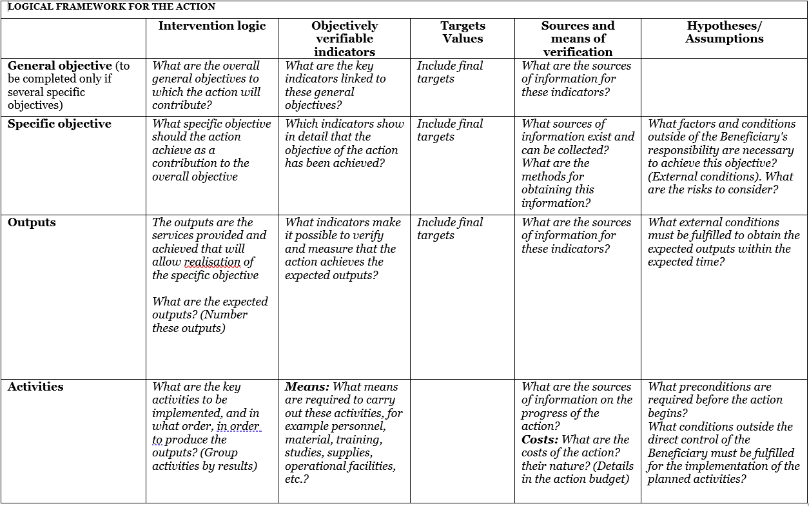
b) M&E logical framework, indicators
3. Proposal template
b) M&E, framework, indicators
Use Annex C: logframe template and explain logic
Notes:
GO: livelihoods
SO: certification & employment

Slide 20
Logical flow
Assumptions & risks
Resources/inputs
Activities
Outputs
Outcome
Impact
3. Proposal template
b) M&E, framework, indicators
Planned work
Intended results
Problem analysis
Stakeholder analysis
Objectives
Risk analysis
Staff
Time
Money
Materials
Equipment
Technology
...
Workshops
Meetings
Field trips
Trainings
Service delivery
...
Number trained, sensitized
Products developed and shared
Equipment distributed
…
Short term
Knowledge/skills acquired
Attitudes changed
Change in behaviour
Decisions made
Actions undertaken
Long term
Social change
Economic change
Environmental change
...
Participant is object
Participant is subject

Slide 21
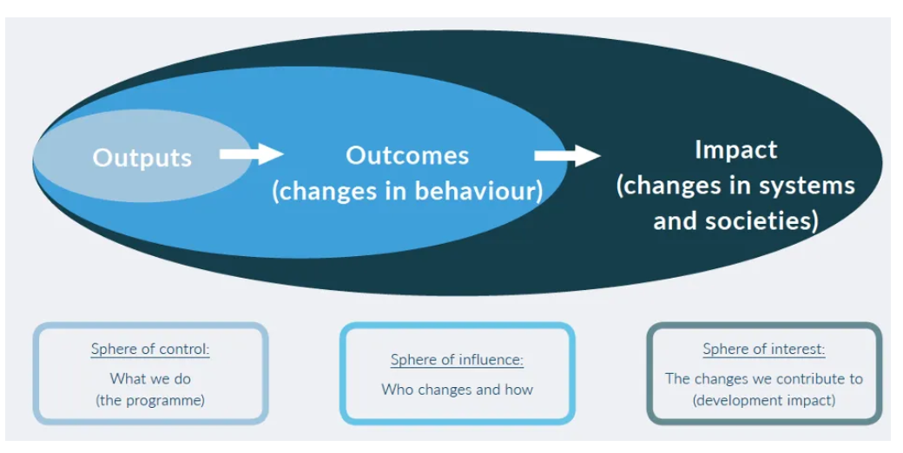
3. Proposal template
b) M&E, framework, indicators

Slide 22
3. Proposal template
b) M&E, framework, indicators

Slide 23
Example Impact/GO
3. Proposal template
b) M&E, framework, indicators
IMPACT - The livelihoods of vulnerable youth, including young women, in Albertine and Rwenzori subregions, are improved and sustained through access to self-employment opportunities
80% of project participants have enhanced their monthly income by at least 20% of monthly income and raised to at least UGX 214,000 net and above by the end of the action
60% of project participants report a 20% increase in the value of their productive and household assets by the end of the action
70% of project participants report a 50% reduction in the number of days their household experiences food insecurity compared to baseline, by the end of the action

Slide 24
Example Outcome/SO
3. Proposal template
b) M&E, framework, indicators
OUTCOME - Vulnerable youth, including young women, start and grow sustainable micro- or small businesses, through enhanced access to quality business development support
X% of project participants have launched a micro-business after completing a business support scheme, by the end of the action
X% of project participants supported to grow their micro-business report increase their performance (operating turnover), by the end of the action
X% of project participants have accessed savings and credit services by the end of the action
# of business partnerships established between project participants and private sector actors, by the end of the action

Slide 25
Example Output/results
3. Proposal template
b) M&E, framework, indicators
# of vulnerable youth supported to start or grow a micro/small business and completing a business support scheme, by the end of the action
# of project participants prepared to access financing and matched with financiers, by the end of the action
# of VSLA groups supported in savings and credit mobilization, accounting management, group governance and linkages to formal finance/credit (ie SACCO or MFI), by the end of the action

Slide 26
3. Proposal template b) M&E, framework, indicators

Slide 27
c) Proposal template - Budget
The budget need to be coherent with the activities in the narrative & action plan
NUMBERING: Activity 1 in the narrative planning need to be transferred to a budget line for activity 1
TIMING: if you plan activity 1 in quarter 1 only, then you will only foresee a budget in quarter 1 for that activity
CODING: Codes correspond with the Logframe: Specific Objective, 01 Result number one,01 Activity Number one under result no One.A0101.3rd level relates to sub activities e.g A010101,A010102
Budget min 150,000 – max 500,000 euro for lot 1
Budget min 150,000 – max 350,000 euro for lot 2

Slide 28
c) Proposal template - Budget
On a daily basis you will work with UGX, but the official max grant amount is in euro which you cannot exceed, so follow up of execution in euro is needed.
FX rate of UGX 4000: 1 EUR (grantees can use their own exchange rate (based on a reliable source) to estimate the budget
Exchange rate losses are ineligible costs and should be covered by the grantees themselves (e.g. through structure costs). Additionally, since the purpose of the grant is not to make money, any gains (exchange or interest) made on the funds received from Enabel must be re-used for the activities after Enabel approval.

Slide 29
c) Proposal template - Budget
The budget is broken down in 3 cost components;
Operational costs (actual activity costs - general means cost): necessary and indispensable cost for achieving the objectives and results of the action, including the cost for achieving verifiable deliverables
Ex : fees for instructors, consultancy fees, fuel for transporting, workshop costs, training materials, food for trainees, fees for trainees etc.
Management costs (costs to support the management team): identified costs related to management, supervision, coordination, monitoring, control, evaluation and financial audit which specifically originate in the implementation of the action or the justification of the Grant
Ex : Salary for staff, Mid-term evaluation, special audit costs
Structure costs (7% max of eligible operational costs) costs related to the achievement of the social purpose of the beneficiary, which cannot be separated or charged to the budget of this action even though they are affected by the implementation of the action. They are a max of 7% of the eligible operational costs.
Ex: supporting staff (those that cannot be justified under management costs through timesheets e.g., procurement), water & electricity & internet of the office etc.

Slide 30
c) Proposal template - Budget
What are the rules concerning structure costs?
The percentage (max.7%) must be justified before signature of the Grant Agreement and correspond to the general structure costs of the grantee
It’s a lump-sum and maximum 7% of operational costs
Once the % has been set and confirmed by the analysis of the grantee’s accounts, no supporting document have to be provided by the grantee. In the reporting, it just appears as a separate line at the end (+ 7%).

Slide 31
c) Proposal template - Budget
Ineligible costs (1/2):
Expenses that are included in the ineligible list (see guidelines)
Expenses that are incurred before or after the duration of this grant agreement
Expenses that cannot be identified, verified and are not included in the grantee's accounts
Expenses not in line with applicable legal fiscal and social provisions
Expenses that are not reasonable, justified, not respecting the principle of good financial management, in particular concerning cost efficiency and effectiveness
Expenses not in line with the action plan, not necessary to achieve the results
No contributions in kind are considered

Slide 32
c) Proposal template - Budget
Ineligible costs (2/2):
Accounting entries not leading to payments
Provisions for liabilities and charges, losses, debts or possible future debts
Debts and debit interests
Doubtful debts
Currency exchange losses
Loans to third parties
Guarantees and securities;
Costs already financed by another grant
Invoices made out by other organisations for goods and services already subsidized
Subcontracting by means of service or consultancy contracts to personnel members, Board members or General Assembly members of the organisation subsidized
Any sub-letting to oneself
Purchases of land or buildings;
Compensation for damage falling under the civil liability of the organisation
Employment termination compensation for the term of notice not performed
Purchase of alcoholic beverages, tobacco and derived products thereof

Slide 33
c) Proposal template - Budget

Slide 34
Indicative Costs
c) Proposal template - Budget

Slide 35
c) Proposal template - Budget
Budget proposal may not differ more than 20% from the initial concept note budget and must remain within the minimum and maximum amounts
Budget presentation in excel (Annex B of the grant agreement)

Slide 36
Budget modifications during implementation
Modification between results leading to a variation not greater than 15% of amounts initially planned.
Modification between activities of the same result leading to a variation not greater than 25% of the amounts initially planned.
Changes between operational costs (A) and management costs (B) are not allowed without an amendment.
Changes to structure costs (C) are not allowed.

Slide 37
c) Proposal template - Budget

Slide 38
4. Application procedure / Next steps
4. Application procedure / Next steps
Use the complete Annex A Grant Application File, Part B. Do not use own templates & do not tweak the template
Submission in English only
Provide a detailed budget (annex B)- Amount requested in the proposal may not vary more than 20% in relation to the initial estimate
Errors or major inconsistencies concerning the points mentioned in the instructions of the form may result in rejection (e.g., content required, pages, …)
Enabel reserves the right to request clarification where the information provided does not enable it to carry out an objective evaluation

Slide 39
Submission concept notes
4. Application procedure / Next steps
Deadline for application: 9/12/2024 at 5 PM EAT
!!! Online submission form – ‘Submit’: https://submit.link/32a
SUBMISSIONS BY EMAIL/POST → AUTOMATIC REJECTION

Slide 40
Application procedure
4. Application procedure / Next steps
Remaining questions: uga_csc_grants@enabel.be
Subject: reference number + LOT
Questions can be submitted until 18/11
Answers will be published on https://www.enabel.be/grants/ latest by 28/11

Slide 41
Application procedure
4. Application procedure / Next steps
! Primary source of information
Guidelines, annexes, clarifications (Q&A) and all other communication & updates:
https://www.enabel.be/grants/
Select UGANDA – OPEN CALLS - FILTER
reference number 22003-10004

Slide 42
Submission proposal
4. Application procedure / Next steps
Online submission form – ‘Submit’: https://submit.link/32a
Avoid last minute submission; System automatically closes when past deadline
Start working on a draft timely (you can always go back to your draft, it saves automatically)
Get documentation (annexes to the application file) ready on time; you cannot proceed to uploading application file before uploading the annexes)

Slide 43
NEXT STEPS
4. Application procedure / Next steps
Invitations to submit the proposals | November 8th, 2024* | NA
Deadline for clarification requests to the contracting authority | November 18th, 2024 | 5:00 pm
Response to clarification requests are given by the contracting authority | November 28th, 2024* | 5:00 pm
Deadline for the submission of the proposals | December 9th, 2024* | 5:00 pm
Opening, administrative checks and evaluation of proposals | December 10th – January 17th, 2025* | NA
Request certificates and supporting documents relating to the grounds for exclusion (see 2.1.1 (2)) | January 17th, 2024* | 5:00 pm
Onsite organizational analysis of the successful applicants after technical evaluation | January 20th – 31st, 2024* | NA
Receipt of certificates and supporting documents relating to the grounds for exclusion | February 3rd, 2024* | 5:00 pm
Notification of the award decision and transmission of signed grant agreement | February 5th, 2024* | NA
Signature of the Agreement by contracting beneficiary | February 7th, 2024* | NA

Slide 44
4. Application procedure / Next steps

